Slide 1

SAP Leonardo Machine Learning Foundation
Cloud Cockpit
CLI
BYOM

Slide 2
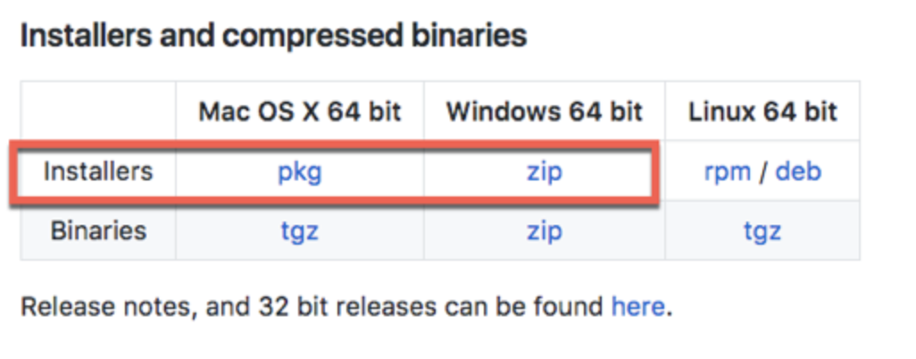
Prerequesites
Install Cloud Foundry (CLI)
Go to Cloud Foundry CLI download page https://github.com/cloudfoundry/cli#downloads
Download and run the installer specific for your platform.
Online Help :
https://developers.sap.com/tutorials/cp-cf-download-cli.html

Slide 3
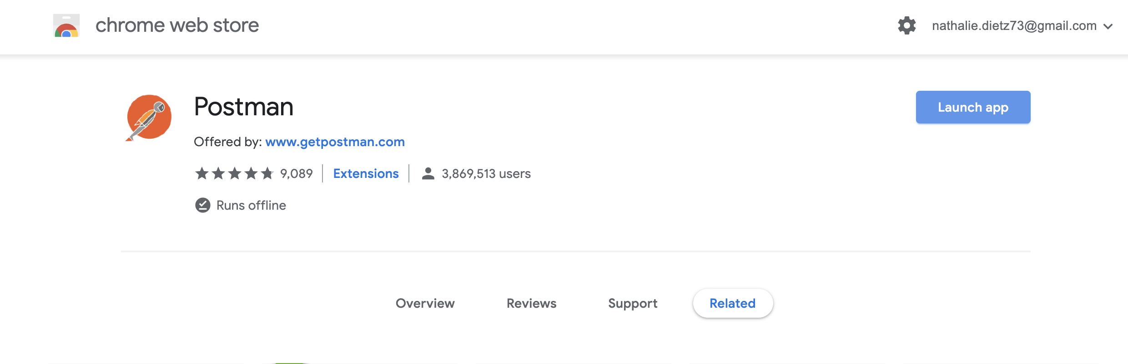
Prerequesites
Install Chrome Postman application
https://chrome.google.com/webstore/detail/postman/fhbjgbiflinjbdggehcddcbncdddomop

Slide 4
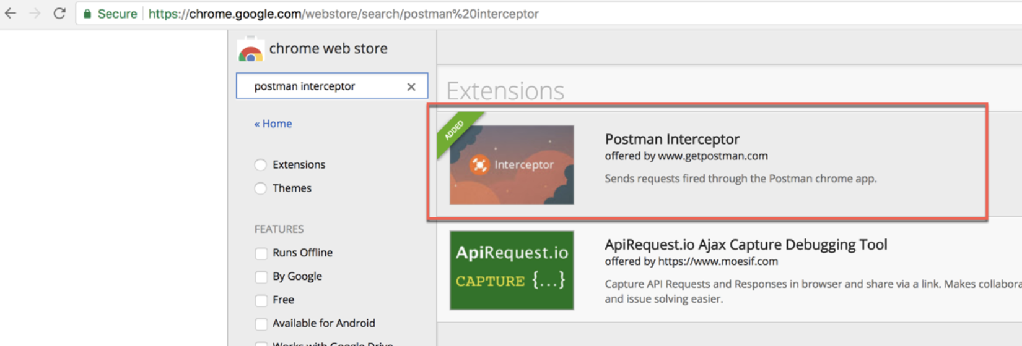
Prerequisites
Install Chrome Postman Interceptor application
Navigate to https://chrome.google.com/webstore/search/postman%20interceptor and select the Postman Interceptor tool

Slide 5
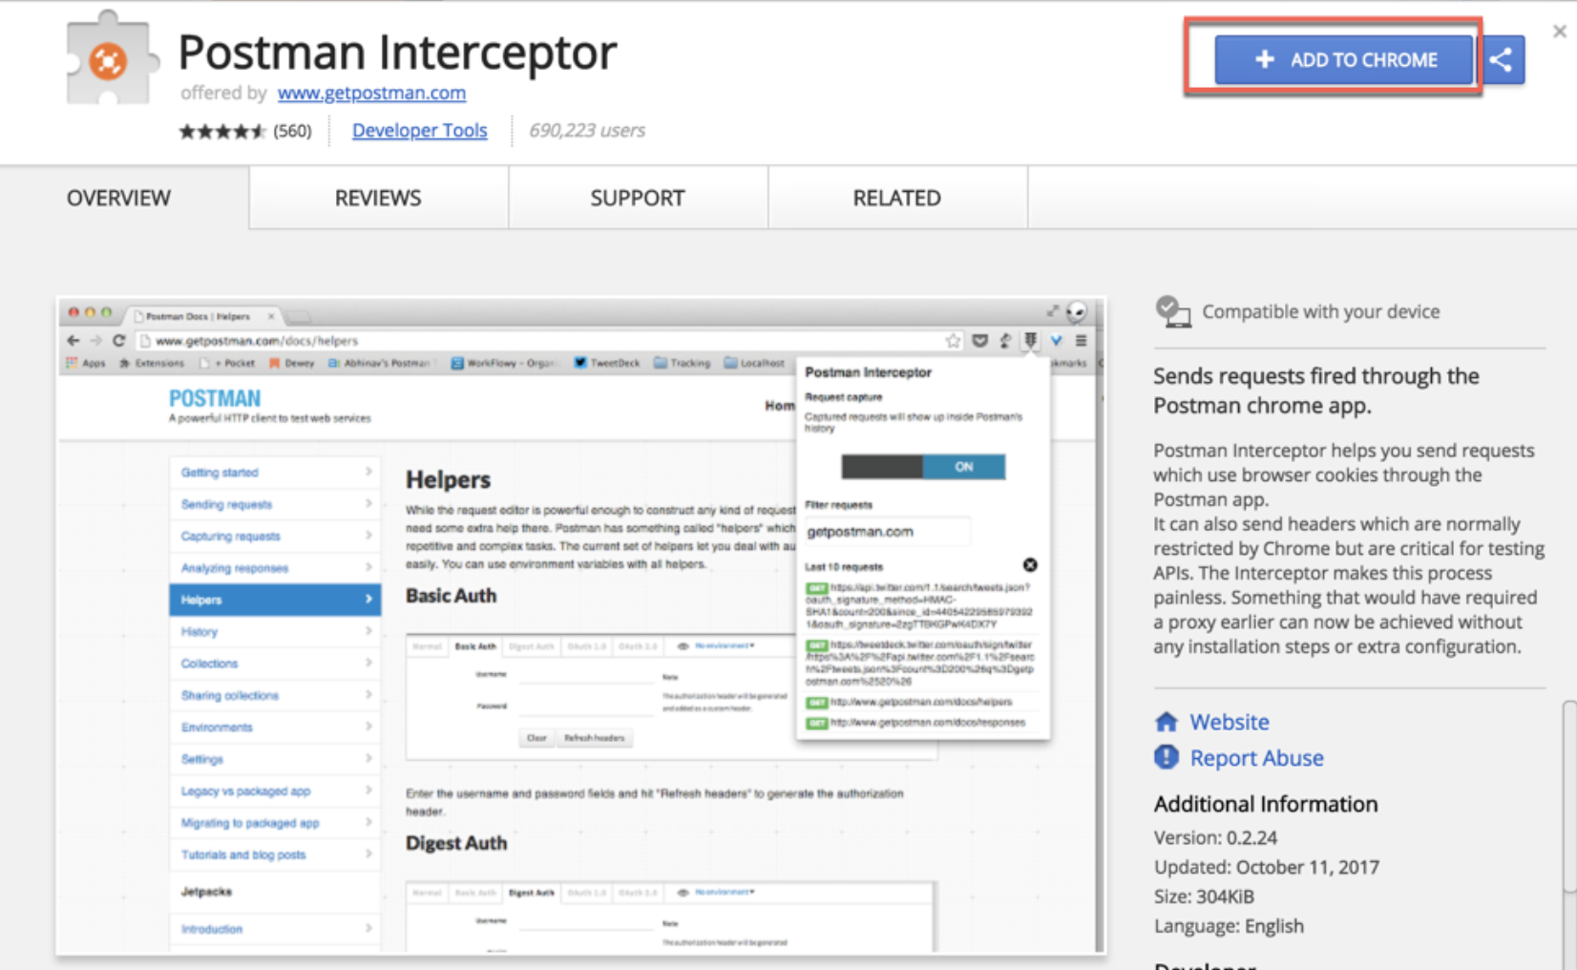
Prequisites
2. Click Add to Chrome

Slide 6
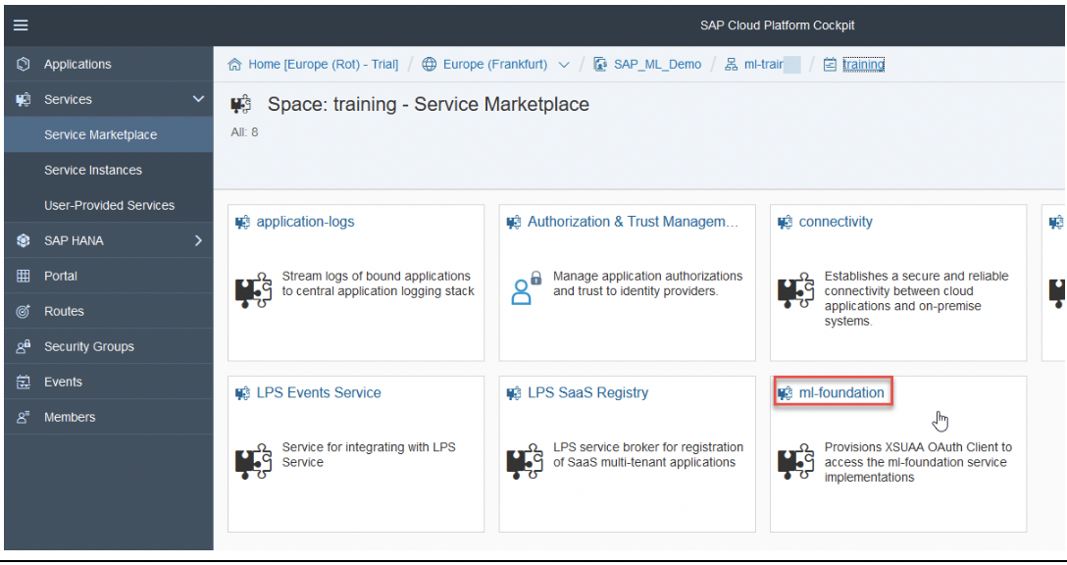
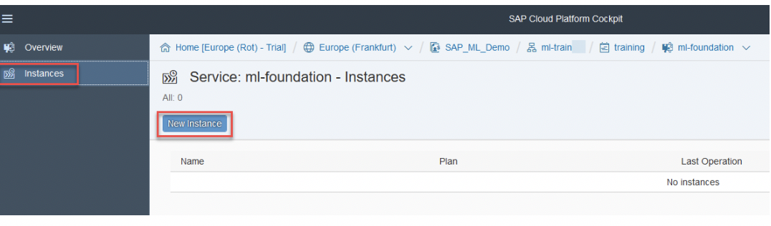
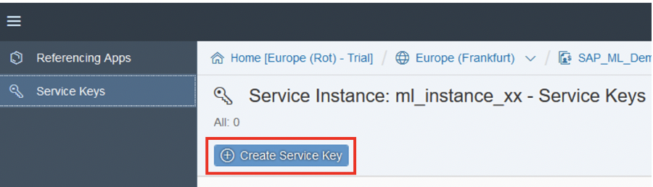
Create ML Foundation Service Instance & Service Key

Slide 7
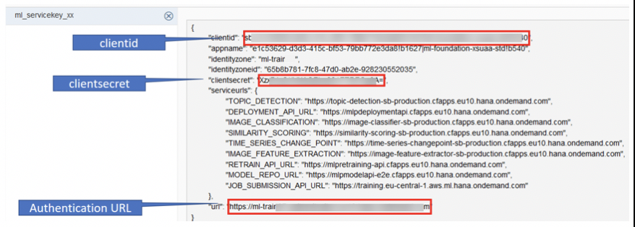
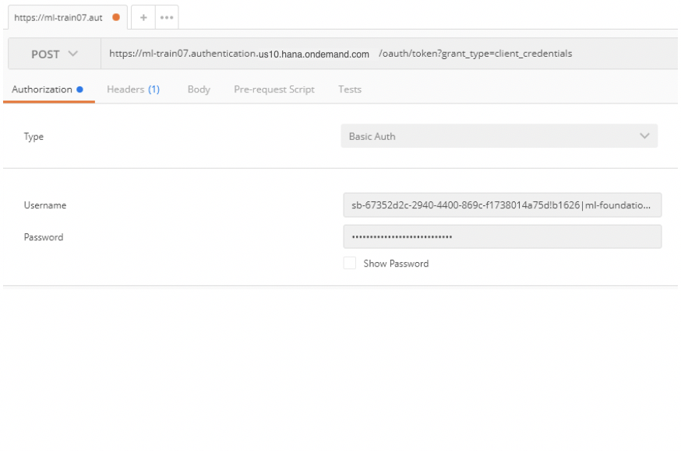
Generate Access Token with Postman (from Chrome)
At the end of the URL add the following string /oauth/token?grant_type=client_credentials

Slide 8
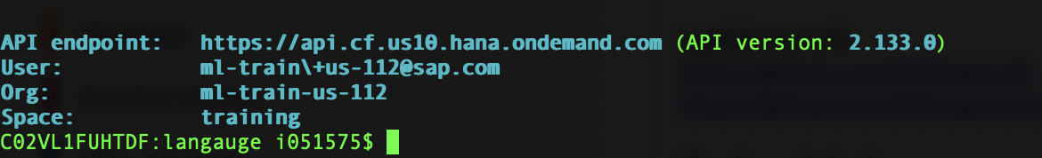
Login to CF CLI
cf login -a api.cf.us10.hana.ondemand.com -u ml-train+us-112@sap.com
Listing all Services
Cf services

Slide 9
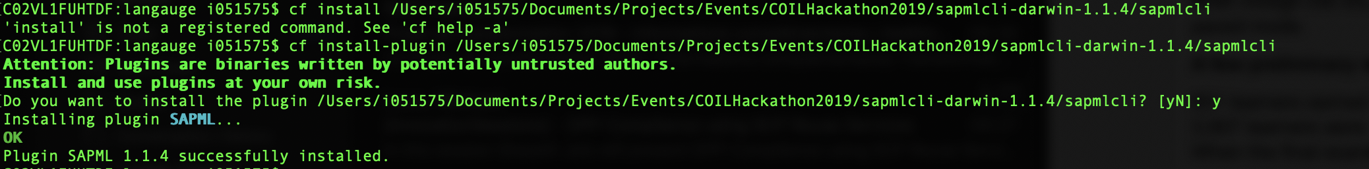
Re-train Image Classification with sapml
cf login -a api.cf.us10.hana.ondemand.com -u ml-train+us-112@sap.com
cf service-key ml_instance_2806 ml_instance_2806_key
Download the SAPML CF plugin from:
https://tools.hana.ondemand.com/#mlfoundation
cf install-plugin -f <your Folder>\sapmlcli

Slide 10
Setting/Getting sapml config
cf sapml config get
cf sapml config set auth_server https://ml-train-us-112.authentication.us10.hana.ondemand.com
cf sapml config set job_api https://training.prod.us-east-1.aws.ml.hana.ondemand.com
cf sapml config set retraining_image_api https://mlfproduction-retrain-image-api.cfapps.us10.hana.ondemand.com/api/v2/image/retraining

Slide 11
Init and list sapml fs (file system)
cf sapml fs init
cf sapml fs list
cf sapml fs list Brands/training/

Slide 12
(Optional) Uploading images before retraining 1
https://help.sap.com/viewer/a86b12f81f424c45a0e7c83c1d5025c4/1904B/en-US/65df4d78cb6b485aab2c9fb11ae89ac1.html
Install Minio
brew install minio/stable/minio
Install minio/mc
brew install minio/stable/mc
Cf sapml fs config // to retrieve credentials and end point

Slide 13
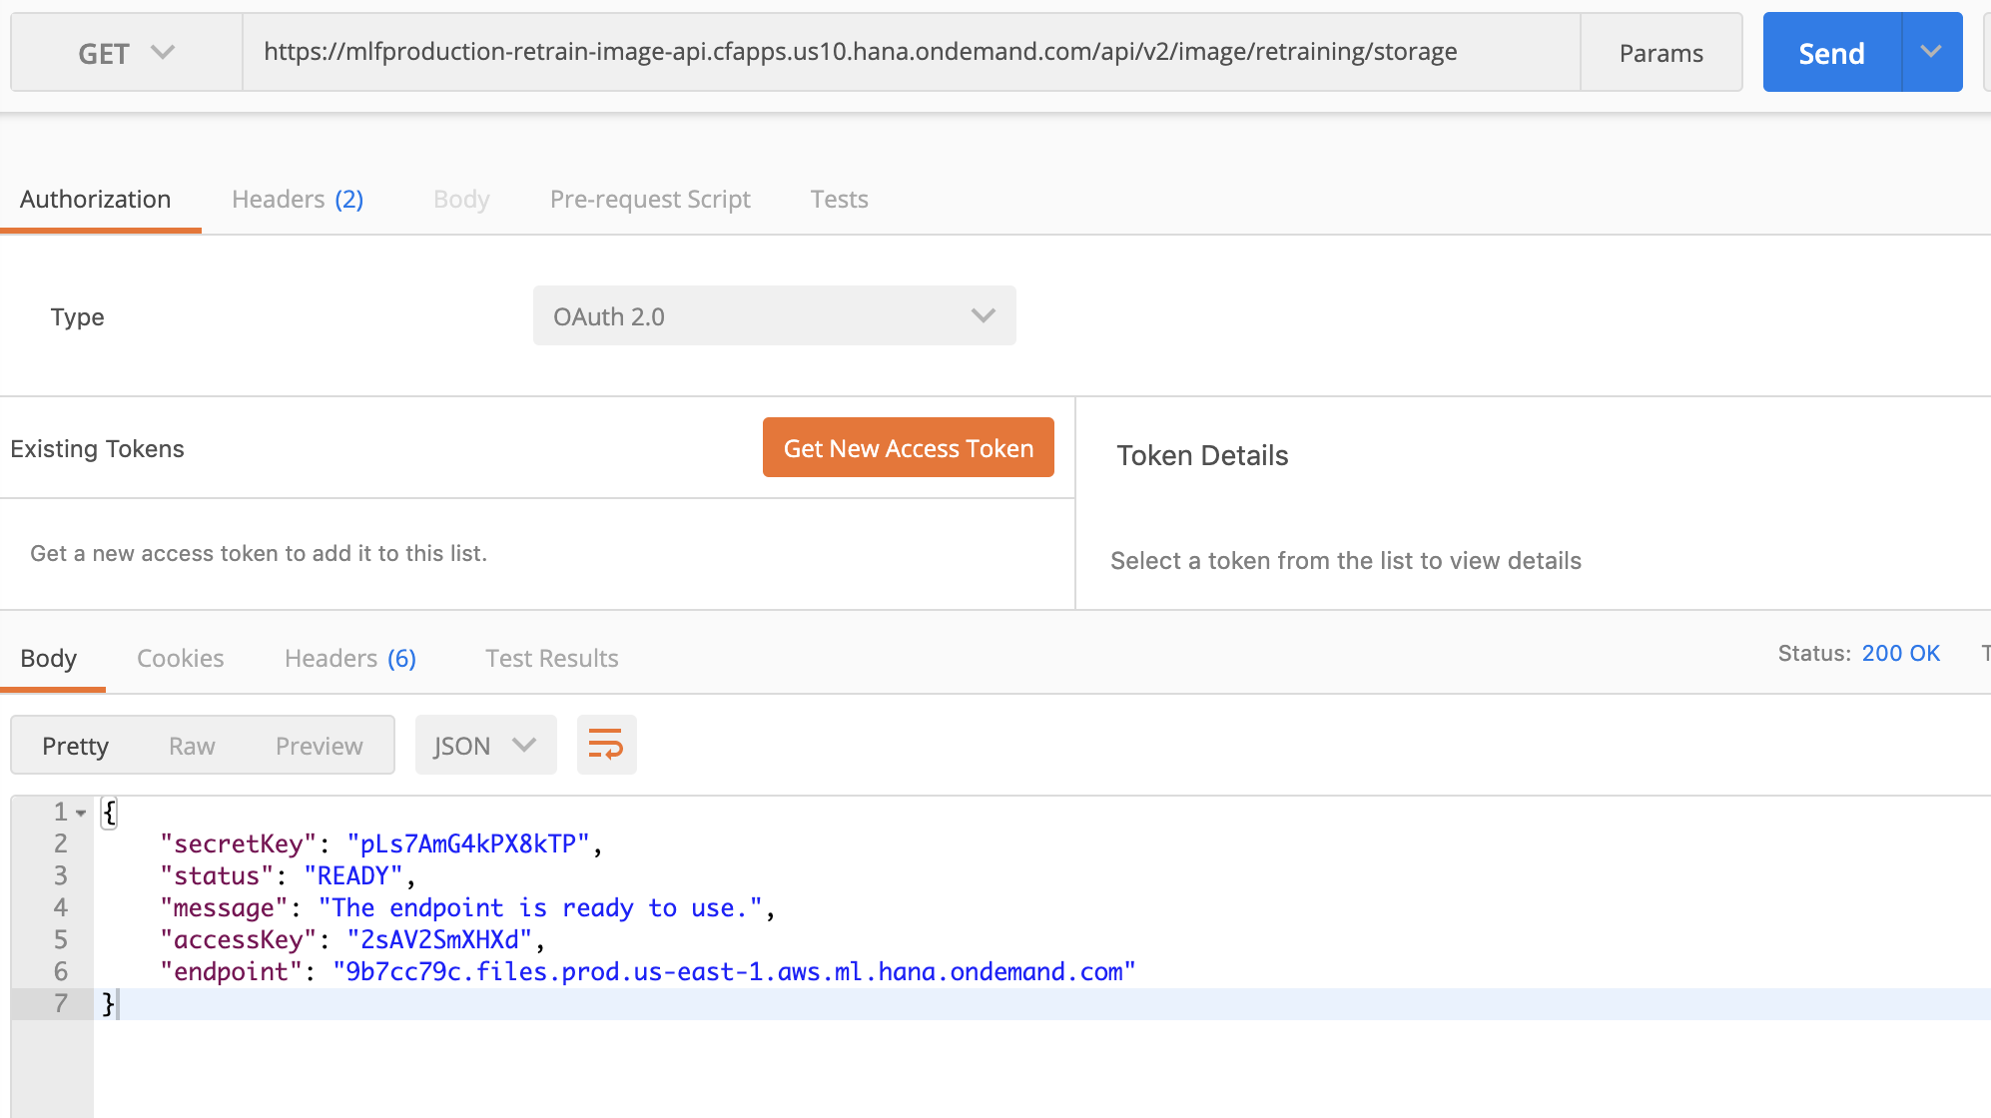
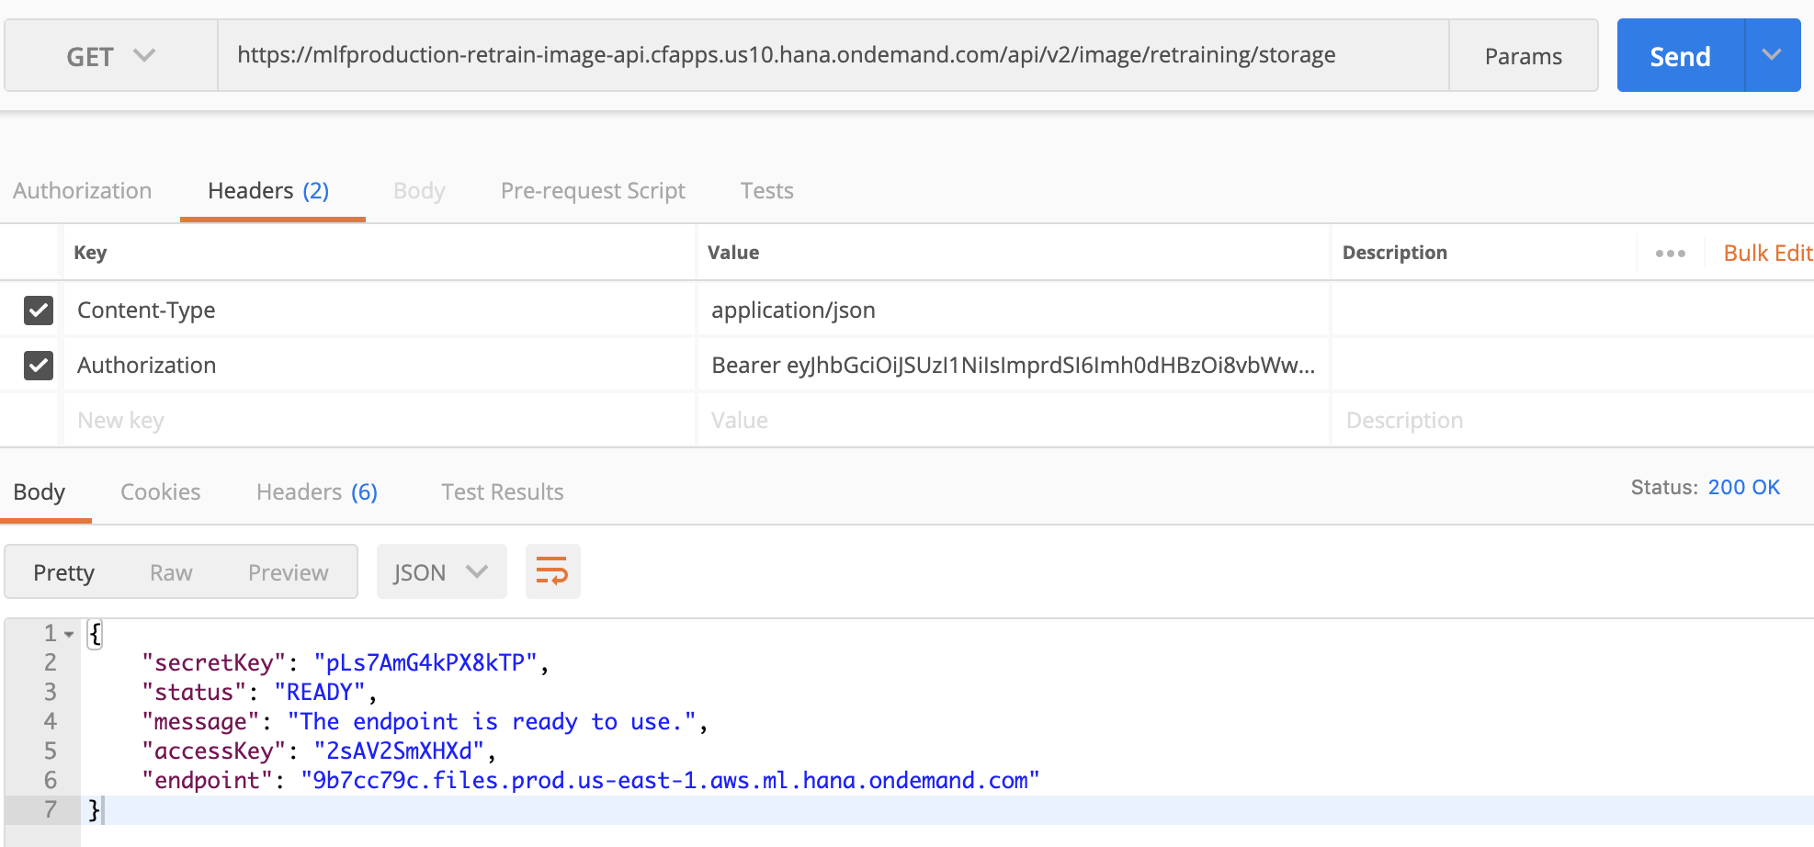
(Optional) Uploading images before retraining 2
To retrieve the credentials, submit a Get request to <IMAGE_RETRAIN_API_URL>/storage.

Slide 14
(Optional) Uploading images before retraining 2
Recursively upload the local directory jewelry_local to remote directory “jewelry” :
add your credentials once:
./mc config host add saps3 https://<endpoint> <access_key> <secret_key>.
You can then upload the file:
./mc cp ~/.../jewelry_local saps3/data/jewelry -- recursive

Slide 15
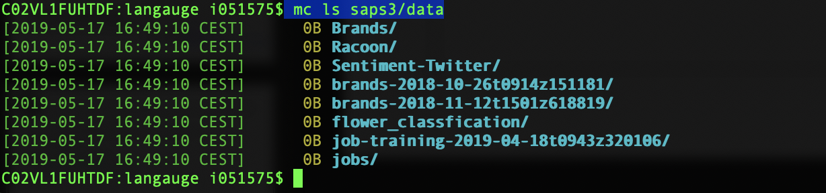
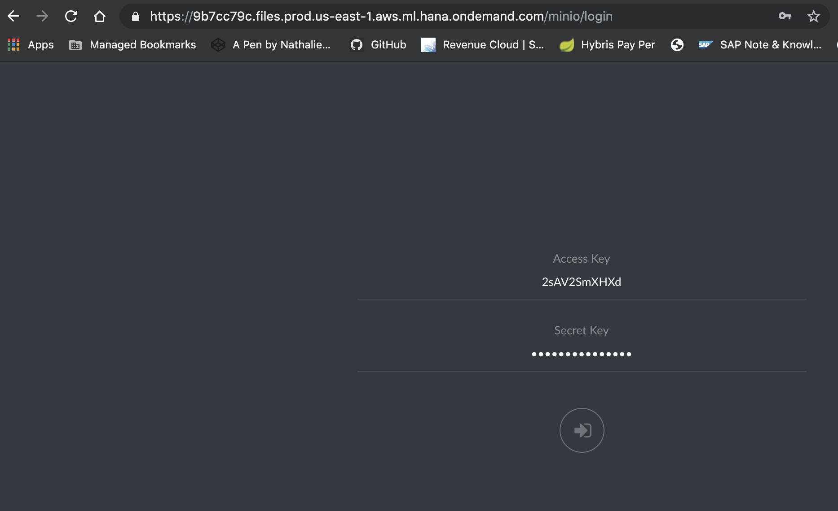
Browsing Repo
Test connection to SAPS3:
Lancer Minio Webserver
https://<end point>

Slide 16
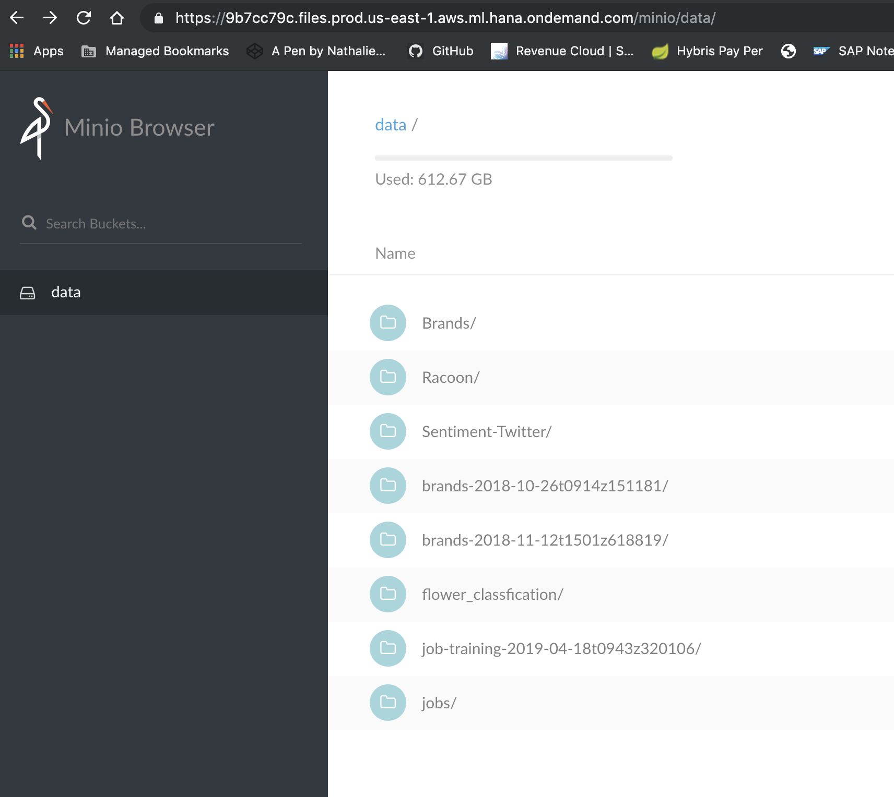
Web Access to SAPS3 repository

Slide 17
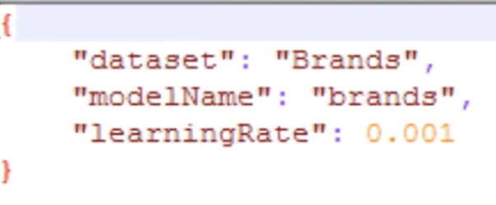
Submit a retraining job
Edit retrain.json
Launching the retraining
cf sapml retraining job_submit retrain.json –m image
Checking the status :
cf sapml retraining jobs –m image
Check Job status with Swagger UI from Retraining URL

Slide 18
Retrieving the logs
List all the jobs :
cf sapml fs list jobs/
Get a log file
cf sapml fs get <job_name>/retraining.log <local_name.log>

Slide 19
Deploying the model
model is stored in a repository and needs to be deployed
Listing all the models that can be deployed :
Cf sapml retraining models –m image
Deploy the model
Cf sapml retraining model_deploy <model_name> <version> -m model
Cf sapml retraining model_deploy Brands1 1 –m image
To get the list of all the models currently deployed
Cf sapml retraining model_deployments –m image

Slide 20
Listing deployed models
Listing all deployed models
Cf sapml modelserver list
Getting info on a deployed model
Cf sapml modelserver get <model_id>
Undeploying a model
Cf sapml modelserver delete <model_id>

Slide 21
Bring Your Own Model
Only TensorFlow is supported 1.3, 1.7, 1.8
Deploy App.py to cloud
cf push
Use Postman POST to test the inference

Slide 22
(Optional) Uploading images before retraining 3
Edit file ~.mc/config.json to add previously retrieved
secretkey
accessKey
Launch Minio Webserver
https://play.min.io:9000/minio/login

Slide 23
Re-train Image Classification with sapml
Enter the command:
cf service-key <instance name> <service key>
to display your service key and make sure that everything is available.
Cf sapml modelserver delete <model_id>

